Slide 1


Progressive Education Society's
Modern College Of Engineering, Pune-05.
Department of Information Technology
Presentation on
Mobile Web Development
Guide By :
Prof. Ms. Supriya Jagtap
Presented by :
Pruthviraj Raut (37053)
Shardul Pharande (37049)
Anushka Satav (37056)

Slide 2

Introduction to Mobile Web Development
Mobile web development focuses on creating websites and applications optimized for mobile devices such as smartphones and tablets. With mobile traffic surpassing desktop, developers must prioritize usability, performance, and aesthetics tailored to smaller screens and touch interfaces. This presentation explores core concepts like Mobile-First design, the nature of mobile web, device differences, and introduces the popular jQuery Mobile framework.
By understanding these fundamentals, developers can deliver seamless, responsive experiences that enhance user engagement no matter the device.

Slide 3
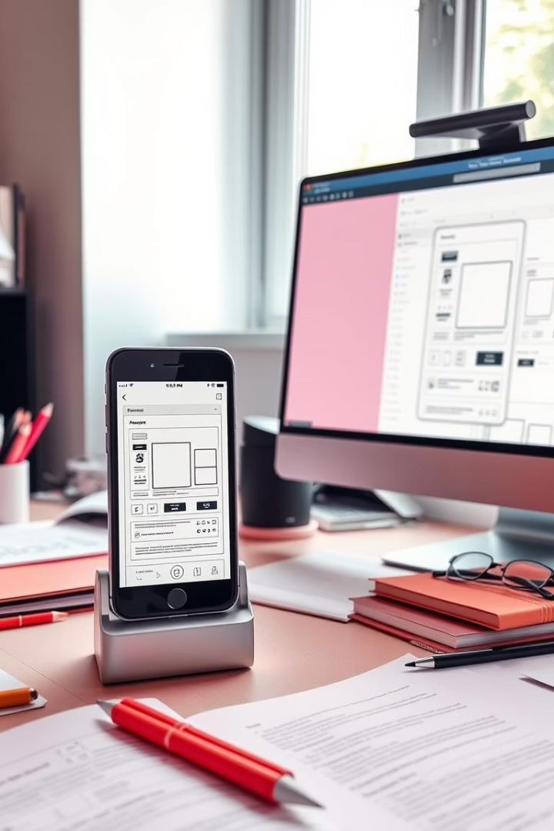
What is Mobile-First Design?
Definition
Advantages
Mobile-First is a design strategy that starts with creating optimized user interfaces for mobile devices before scaling up to larger screens like desktops.
This approach ensures essential content and features are prioritized, improves performance by focusing on smaller devices first, and enhances overall accessibility.
Implementation
Often achieved through progressive enhancement and responsive CSS techniques that adapt layouts and interactions based on screen size.

Slide 4
Understanding the Mobile Web
Definition
Challenges
The Mobile Web refers to accessing websites through mobile devices' browsers, requiring optimized content for various network speeds and screen sizes.
Developers must handle diverse devices, slower network connections, and limited screen real estate while maintaining usability and performance.
Uses responsive web design
Fragmented operating systems
Prioritizes fast loading
Varying hardware capabilities
Focuses on touch interactions
Battery and resource constraints

Slide 5
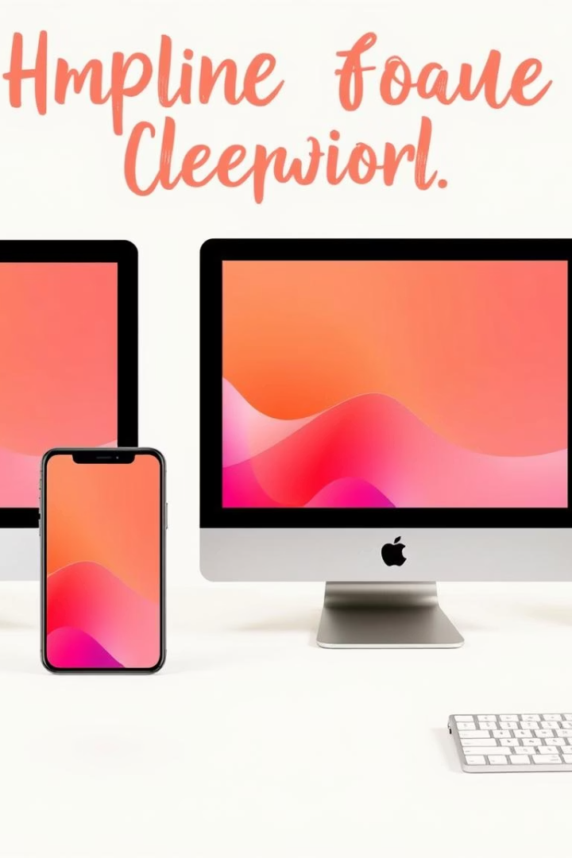
Mobile Devices vs Desktop: Key Differences
Factor
Mobile Devices
Desktop
Screen Size
Small, varied sizes (4-7 inches)
Large monitors (13+ inches)
Input Method
Touchscreen with gestures
Keyboard and mouse
Performance
Limited CPU/GPU, battery-powered
More powerful hardware, no battery constraints
Connectivity
Mobile networks, variable speed
Usually stable broadband

Slide 6

Introduction to jQuery Mobile Framework
What is jQuery Mobile?
Core Features
A touch-optimized web framework built on jQuery, designed to simplify mobile web development with a unified UI system and broad device compatibility.
Includes responsive page layouts, navigation system, support for themes, animations, and a rich set of UI widgets designed specifically for mobile.
Benefits
Speeds up development, ensures cross-platform consistency, and reduces the need to write device-specific code.

Slide 7

Setting Up jQuery Mobile
Include jQuery Core
Include jQuery Mobile
Create Basic HTML Structure
Add the jQuery library, which jQuery Mobile depends on, typically via a CDN link in your HTML.
Reference the jQuery Mobile JavaScript and CSS files, also often loaded from a CDN for ease and speed.
Use data-role attributes in your HTML to define pages, headers, footers, and content areas conforming to jQuery Mobile standards.

Slide 8
jQuery Mobile Core Components
Pages & Layouts
Widgets
Themes & Icons
Organize content into multiple pages with smooth transitions and layers, supporting consistent headers, footers, and content areas.
Includes buttons, sliders, popup dialogs, collapsibles, form elements, and list views with enhanced usability on mobile devices.
Customizable CSS themes control the look and feel, while built-in icon sets add visual clarity and improve navigation.

Slide 9




Events, Forms & Data Attributes in jQuery Mobile
Events
Forms
Data Attributes
jQuery Mobile supports touch events like tap, swipe, and orientationchange to improve interactivity.
Enhanced form controls including sliders, switches, and select menus make input intuitive and mobile-friendly.
Use HTML5 data-* attributes (e.g., data-role, data-theme) to declaratively control widgets, pages, and transitions without extra scripting.

Slide 10
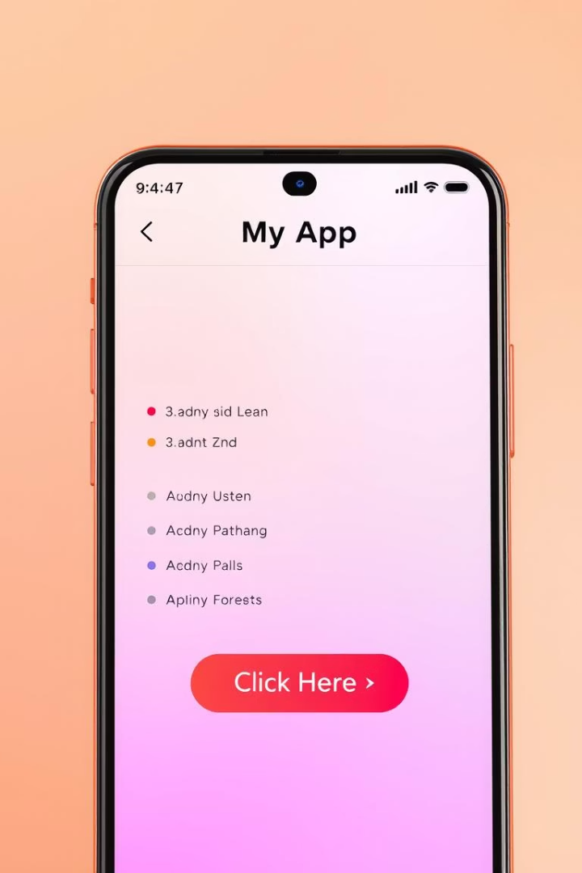
Building a Simple Mobile Webpage with jQuery Mobile
Define Pages
Use div elements with data-role="page" to create each logical page in the application.
Add Headers and Footers
Include page headers and footers with appropriate data-role to maintain consistent layout and navigation.
Use Built-in Widgets
Add list views, buttons, and form elements with data-attributes for enhanced mobile-friendly UI components.

Slide 11

Summary and Next Steps in Mobile Web Development
Key Takeaways
Embrace Mobile-First to prioritize essential features and improve UX.
Understand device differences to tailor responsive designs effectively.
Leverage jQuery Mobile to accelerate development with ready-made UI components.
Next Steps
Experiment building simple mobile pages with jQuery Mobile.
Explore advanced features like custom themes and event handling.
Stay updated on evolving frameworks and best practices in mobile web development.
With these foundations, developers are well-equipped to craft engaging, performant mobile web applications that deliver excellent user experiences across devices.

